Slide 1
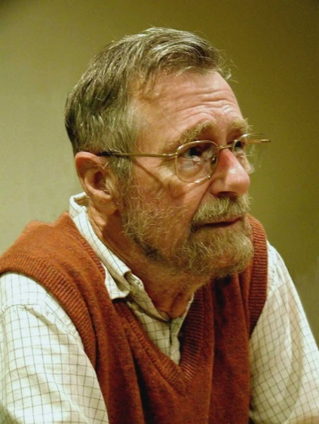
Dijkstra's Shortest Path
Programming – AI for Games
Last modified 09/02/16 by Sam Cartwright

Slide 2
Contents
Why do we need the shortest path?
Graphs for Pathfinding
Breadth First Search review
Dijkstra’s Algorithm

Slide 3
Why do we need the shortest path?
Many techniques require the shortest path in a graph, including finding the shortest path between two locations in a game level or finding the least amount of moves required in a board-game to win from the current arrangement of game pieces.

Slide 4
Graphs For Pathfinding
One of the most common uses for graphs in games is pathfinding.
Being able to calculate how to get from point A to B in a game level.
Why not just move from A to B?
There could be obstacles or complex geometry blocking a straight line path between the two.

Slide 5
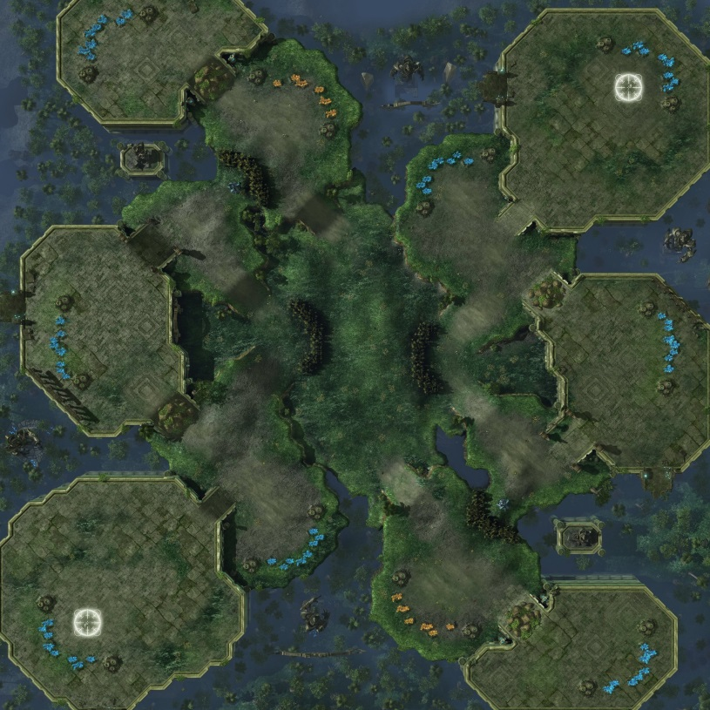
An Example
This is Steppes of War
A map in Starcraft 2

Slide 6
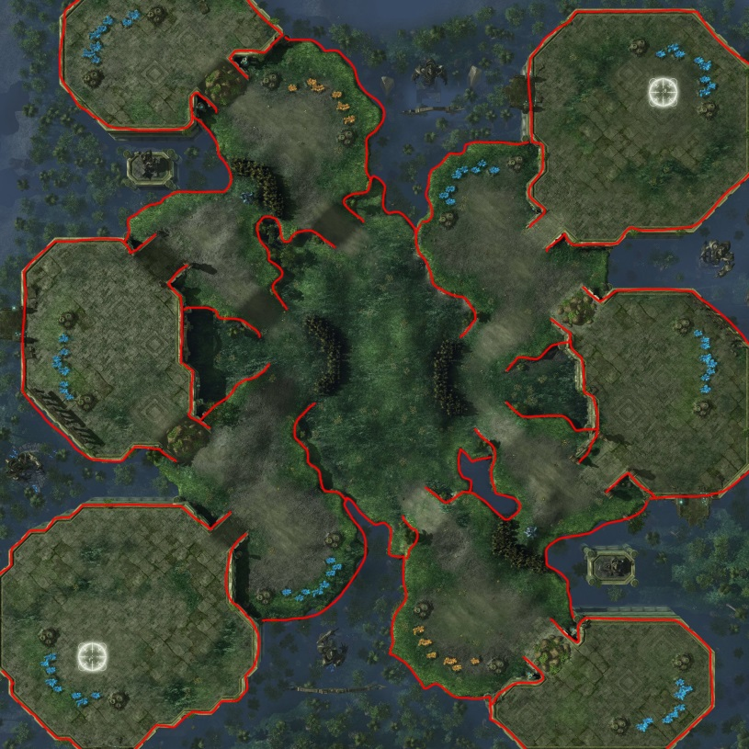
An Example
The walls are hard to see so I’ve drawn over them.

Slide 7
An Example
The walls are hard to see so I’ve drawn over them.
Lets say the player selected a unit here.

Slide 8
An Example
The walls are hard to see so I’ve drawn over them.
Lets say the player selected a unit here.
And told them to move over here.

Slide 9
An Example
If we just told the unit to move towards the goal.

Slide 10
An Example
It would run into the wall here.

Slide 11
An Example
The correct path looks more like this.

Slide 12
Graphs For Pathfinding
We solve the problem by filling the map with nodes.
Nodes represent a position and are only connected to another node if there is a straight line path between them.
To find the path, we now need to find the shortest path, along the edges from the starting node to the goal node.

Slide 13
Breadth First Search Review
Breadth First Search (BFS) fans out from the starting node in all directions until all connected nodes are processed.
Uses a queue to generate the order of the nodes it traverses.

Slide 14
Dijkstra’s Algorithm
Dijkstra’s Algorithm is a modification of BFS that allows us to find the shortest distance from any two nodes on a weighted graph.
For an unweighted graph, you can just treat all edges as having a weight of 1.
It makes two changes from vanilla BFS.
It adds a running count of the distance from the start to each node it traverses.
It uses a priority queue to pick the next node.

Slide 15
Dijkstra’s Algorithm
Given this weighted graph, what paths can get us from node 0 to node 4?
And from those paths which is the shortest?
Just looking at the graph, we can tell that there are 2 main options
2
0
1
3
3
5
2
1
4
5
3
6
4
4

Slide 16
Dijkstra’s Algorithm
Given this weighted graph, what paths can get us from node 0 to node 4?
And from those paths which is the shortest?
Just looking at the graph, we can tell that there are 2 main options
2
0
1
3
3
5
2
1
4
5
3
6
4
4

Slide 17
Dijkstra’s Algorithm
Given this weighted graph, what paths can get us from node 0 to node 4?
And from those paths which is the shortest?
Just looking at the graph, we can tell that there are 2 main options
2
0
1
3
3
5
2
1
4
5
3
6
4
4

Slide 18
Dijkstra’s Algorithm
The first path 0->5->4 costs a total of
6 + 5 = 11
The second path 0->1->2->3->4 costs
2+3+1+4 = 10
So the second path is the fastest, even though it takes us through more nodes
2
0
1
3
3
5
2
1
4
5
3
6
4
4

Slide 19
Dijkstra’s Algorithm
So how do we get a computer to figure this out?
2
0
1
3
3
5
2
1
4
5
3
6
4
4

Slide 20
Dijkstra’s Algorithm
First we need to add two new pieces of information to each node.
The previous node we came from
The “G score”, or total traversal cost to get to this node
2
0
1
3
3
5
2
1
4
5
3
6
4
4

Slide 21
Dijkstra’s Algorithm
N
G
N
G
First we need to add two new pieces of information to each node.
The previous node we came from
The “G score”, or total traversal cost to get to this node
2
0
1
3
3
5
N
G
2
1
N
G
4
N
G
5
3
6
G
N
4
4

Slide 22
Dijkstra’s Algorithm
N
G
N
G
I mentioned a priority queue before.
With the regular queue in BFS, when getting the top node it will return the one pushed first.
The priority queue will return the node with the lowest G-score.
2
0
1
3
3
5
N
G
2
1
N
G
4
N
G
5
3
6
G
N
4
4

Slide 23
Dijkstra’s Algorithm
Dijkstra’s algorithm is:
Set all Ns to null, set all Gs to infinity
Push start node onto priority queue, set its N to itself and its G to 0
While queue not empty
Get the current node off the end of the queue and remove it.
Mark it as traversed
Loop through its edges
If end node not traversed
Calculate current node’s G + the edge cost
If cost is less than existing G cost in end node
Set end node’s N to the current node
Set end node’s G to the current node’s G + the edge cost
If end node not in the queue
Push end node onto the queue

Slide 24
Dijkstra’s Algorithm
N
G
2
N
G
Priority Queue:
0
1
= untraversed
3
3
5
N
G
= traversed
2
1
N
G
4
N
G
5
3
6
G
N
4
4

Slide 25
Dijkstra’s Algorithm
-
∞
2
-
∞
Priority Queue:
0
1
= untraversed
3
3
5
-
∞
= traversed
2
1
-
∞
4
-
∞
5
3
6
∞
-
4
4
Notes:
Set all costs to infinity
Set all prev nodes to null

Slide 26
Dijkstra’s Algorithm
0
0
2
-
∞
Priority Queue:
0
1
0
= untraversed
3
3
5
-
∞
= traversed
2
1
-
∞
4
-
∞
5
3
6
∞
-
4
4
Notes:
Push start node onto the queue

Slide 27
Dijkstra’s Algorithm
0
0
2
0
2
Priority Queue:
0
1
= untraversed
3
3
5
-
∞
= traversed
2
1
0
5
4
-
∞
5
3
6
∞
-
4
4
Notes:
Take start node off the queue, set all its neighbours costs and prev’s acordingly

Slide 28
Dijkstra’s Algorithm
0
0
2
0
2
Priority Queue:
0
1
= untraversed
3
3
5
-
∞
= traversed
2
1
0
5
4
-
∞
5
3
6
∞
-
4
4
Notes:
Set it as marked

Slide 29
Dijkstra’s Algorithm
0
0
2
0
2
Priority Queue:
0
1
1
= untraversed
3
3
5
-
∞
= traversed
2
1
0
5
4
-
∞
5
3
6
∞
-
4
4

Slide 30
Dijkstra’s Algorithm
0
0
2
0
2
Priority Queue:
0
1
1
5
= untraversed
3
3
5
-
∞
= traversed
2
1
0
5
4
-
∞
5
3
6
∞
-
4
4
Notes:
Push its neighbours onto the queue

Slide 31
Dijkstra’s Algorithm
0
0
2
0
2
Priority Queue:
0
1
5
= untraversed
3
3
5
1
5
= traversed
2
1
0
5
4
-
∞
5
3
6
∞
-
4
4
Notes:
1 had the lowest cost so it comes off the queue.
Set its neighbours costs and prev

Slide 32
Dijkstra’s Algorithm
0
0
2
0
2
Priority Queue:
0
1
5
= untraversed
3
3
5
1
5
= traversed
2
1
0
5
4
-
∞
5
3
6
∞
-
4
4
Notes:
Set as marks

Slide 33
Dijkstra’s Algorithm
0
0
2
0
2
Priority Queue:
0
1
5
2
= untraversed
3
3
5
1
5
= traversed
2
1
0
5
4
-
∞
5
3
6
∞
-
4
4
Notes:
Add neighbours to queue

Slide 34
Dijkstra’s Algorithm
0
0
2
0
2
Priority Queue:
0
1
2
= untraversed
3
3
5
1
5
= traversed
2
1
0
5
4
-
∞
5
3
6
11
5
4
4
Notes:
Take 5 off queue
Set neighbours costs and prev

Slide 35
Dijkstra’s Algorithm
0
0
2
0
2
Priority Queue:
0
1
2
= untraversed
3
3
5
1
5
= traversed
2
1
0
5
4
-
∞
5
3
6
11
5
4
4
Notes:
Set 5 as marked

Slide 36
Dijkstra’s Algorithm
0
0
2
0
2
Priority Queue:
0
1
2
4
= untraversed
3
3
5
1
5
= traversed
2
1
0
5
4
-
∞
5
3
6
11
5
4
4
Notes:
Add node 4 to queue

Slide 37
Dijkstra’s Algorithm
0
0
2
0
2
Priority Queue:
0
1
4
= untraversed
3
3
5
1
5
= traversed
2
1
0
5
4
2
6
5
3
6
11
5
4
4
Notes:
Take 2 off queue
Set neighbours

Slide 38
Dijkstra’s Algorithm
0
0
2
0
2
Priority Queue:
0
1
4
= untraversed
3
3
5
1
5
= traversed
2
1
0
5
4
2
6
5
3
6
11
5
4
4
Notes:
Set marked

Slide 39
Dijkstra’s Algorithm
0
0
2
0
2
Priority Queue:
0
1
3
= untraversed
4
3
3
5
1
5
= traversed
2
1
0
5
4
2
6
5
3
6
11
5
4
4
Notes:
Add node 3 to queue

Slide 40
Dijkstra’s Algorithm
0
0
2
0
2
Priority Queue:
0
1
4
= untraversed
3
3
5
1
5
= traversed
2
1
0
5
4
2
6
5
3
6
10
3
4
4
Notes:
10 is less than 11 so replace existing costs with new ones

Slide 41
Dijkstra’s Algorithm
0
0
2
0
2
Priority Queue:
0
1
4
= untraversed
3
3
5
1
5
= traversed
2
1
0
5
4
2
6
5
3
6
10
3
4
4

Slide 42
Dijkstra’s Algorithm
0
0
2
0
2
Priority Queue:
0
1
= untraversed
3
3
5
1
5
= traversed
2
1
0
5
4
2
6
5
3
6
10
3
4
4

Slide 43
Dijkstra’s Algorithm
0
0
2
0
2
Priority Queue:
0
1
= untraversed
3
3
5
1
5
= traversed
2
1
0
5
4
2
6
5
3
6
10
3
4
4

Slide 44
Dijkstra’s Algorithm
0
0
0
2
Now that the algorithm has run, if we start at any node (not just 4) and follow the previous pointers back, we get the shortest path from that node back to node 0.
Starting at 4, it points back to 3 then to 2, then 1 and finally 0.
If we reverse this list we get
0->1->2->3->4
The shortest path!
2
0
1
3
3
5
1
5
2
1
0
5
4
2
6
5
3
6
10
3
4
4

Slide 45
Dijkstra’s Algorithm
Its important to note that Dijkstra’s does calculate the shortest path from the start node to every other node in the graph.
This means for small graphs, we could just pre-calculate Dijkstra’s for every node and we would know the shortest path from every node to every other node.
For anything other than small graphs, this takes a prohibitively large amount of memory to store all the results.
It also means you can’t dynamically change the map, or the weights without recalculating every node again.
Dijkstra’s is also quite expensive to run for larger graphs.
To solve all of these problems we turn to a new algorithm, called A*

Slide 46
Summary
Pathfinding is one of the most common applications for shortest path algorithms
Needed to navigate obstacles or complex geometry
For pathfinding to work, we first build a graph of nodes
Breadth First Search will navigate a graph by fanning out in all directions from the starting node
Dijkstra’s algorithm uses a modified BFS
Dijkstra’s will find the shortest path to every other node in the graph
Is expensive to run for larger graphs

Slide 47
References
Ian Millington, 2009. Artificial Intelligence for Games. 2 Edition. CRC Press.

